Slide 1
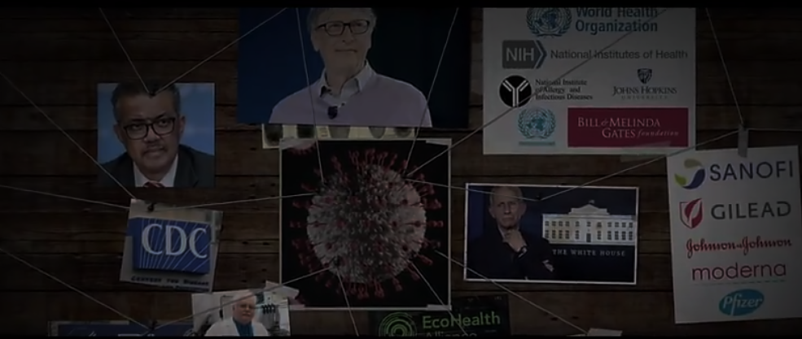
This MANDATORY INJECTION was planned in 2015 by the COVID RICO CONSPIRATORS
“…until an infectious disease crisis is very real, present, and at an emergency threshold, it is often largely ignored. To sustain the funding base beyond the crisis, he said, we need to increase public understanding of the need for MCMs such as a pan-influenza or pan-coronavirus vaccine. A key driver is the media, and the economics follow the hype. We need to use that hype to our advantage to get to the real issues. Investors will respond if they see profit at the end of process, Daszak stated.”
2016 Feb 12. 6, Developing MCMs for Coronaviruses. Available from: https://www.ncbi.nlm.nih.gov/books/NBK349040/

Slide 2
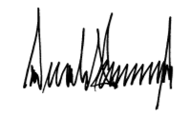
In recognition of these limitations, the President signed the Executive Order on Modernizing Influenza Vaccines in the United States to Promote National Security and Public Health on September 19, 2019. Broadly, the Executive Order directs BARDA, CDC, NIH, and FDA to accelerate the adoption of improved influenza vaccine technologies. In alignment with the goals of the Executive Order, NIAID is conducting and supporting research to develop state-of-the-art vaccine platform technologies that could be used to develop universal influenza vaccines as well as to improve the speed and agility of the influenza vaccine manufacturing process. These platform technologies include DNA, messenger RNA (mRNA), virus-like 5 particles, vector-based, and self-assembling nanoparticle vaccines. For example, NIAID supported scientists are investigating an mRNA vaccine candidate that would allow for a more rapid and flexible response to both seasonal and pandemic influenza than do existing vaccine production strategies.
https://energycommerce.house.gov/sites/democrats.energycommerce.house.gov/files/documents/Testimony%20-%20Fauci%20%28NIH%29%2012.04.2019.pdf

Slide 3
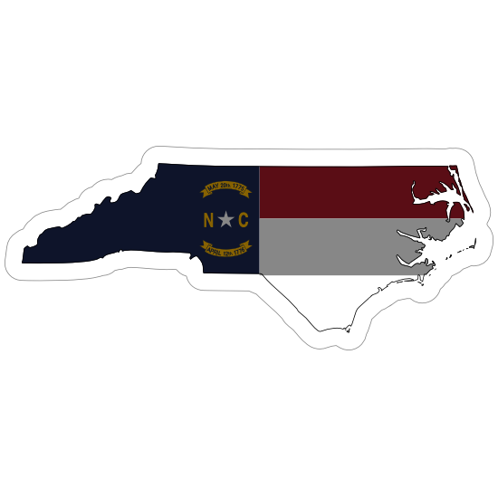
March to a UNIVERSAL VACCINE… Tar on their Heels…Blood on their hands
HIV Inc
(1984)
Immunity
Shield
“The Act”
(1986)
Wellcome
AZT Patent Challenge Fails
(1991-1996)…
…and expires
UNC Chapel Hill Begins Gain of Function (Weaponization) of CoV for Vaccine Platform
1996 - 1999
Fauci and Baric
Make FrankenCoV…
…and patent it
1999 - 2002

Slide 4
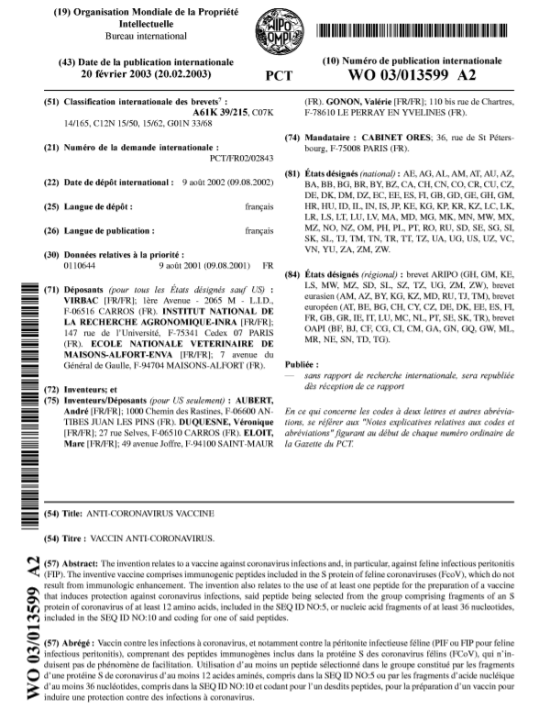
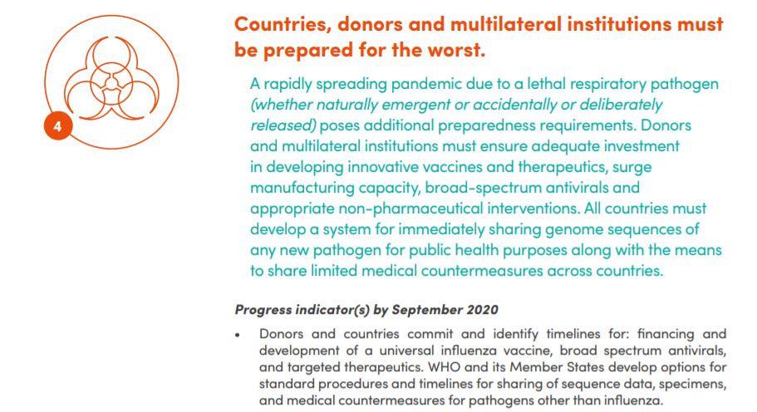
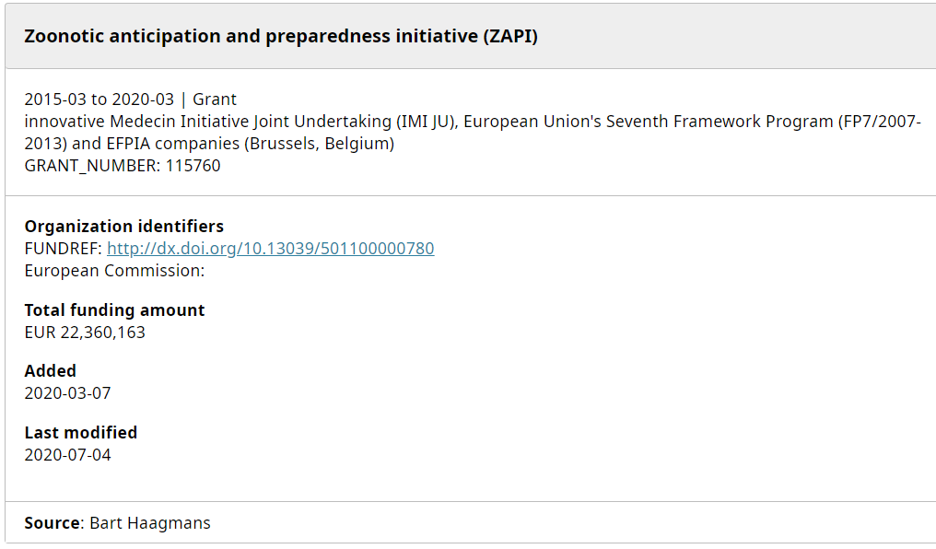
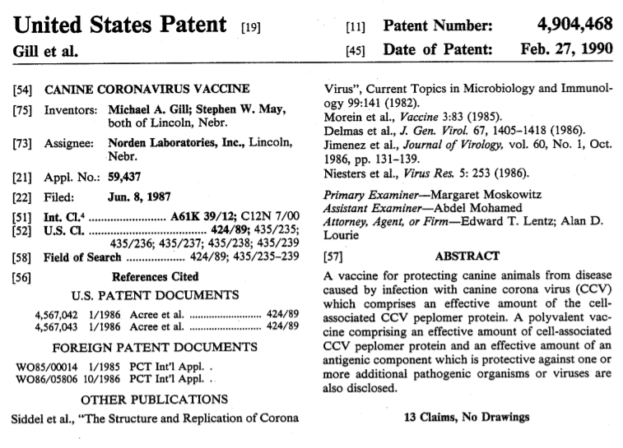
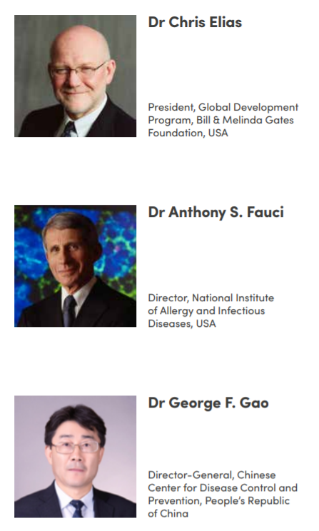
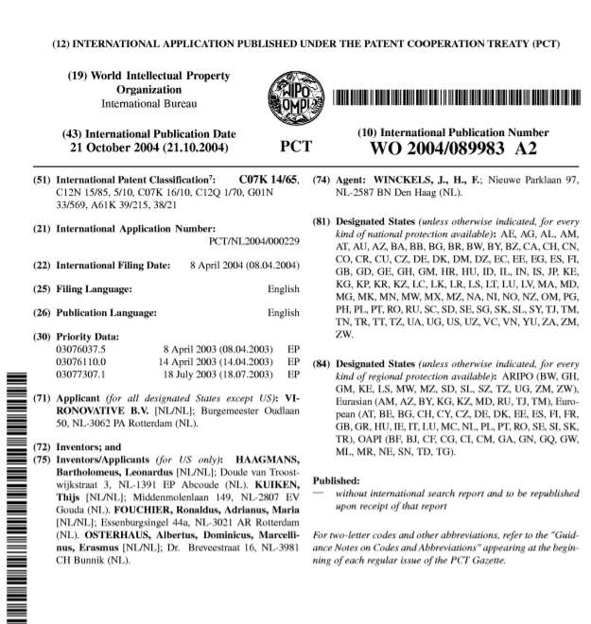
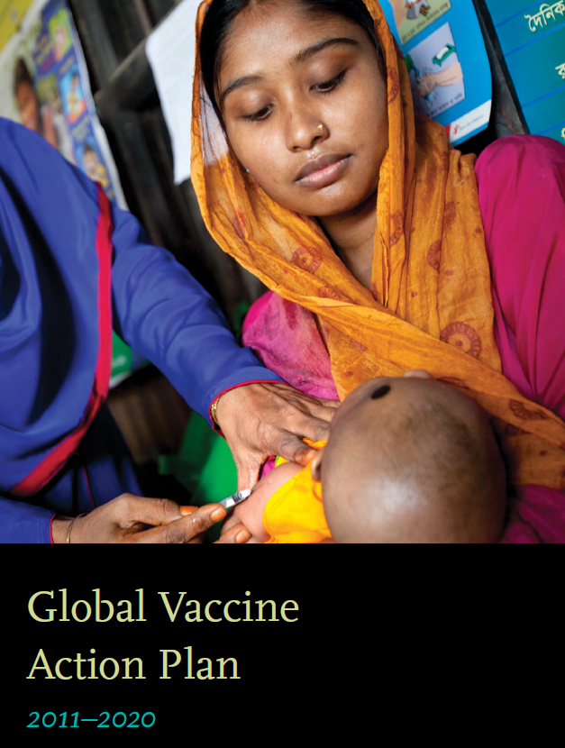
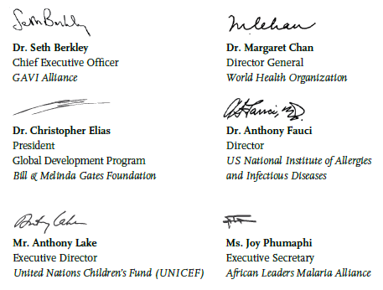
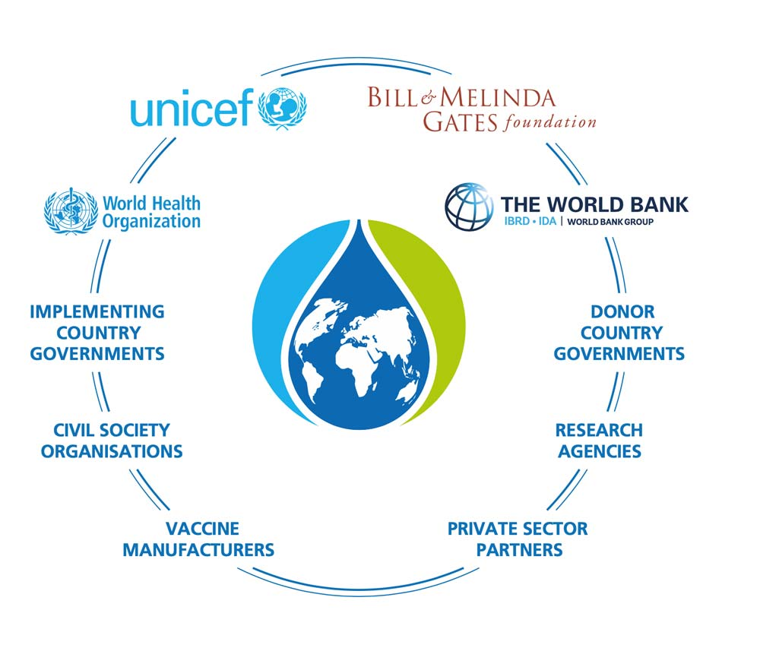
The COVID World at VAX

Slide 5
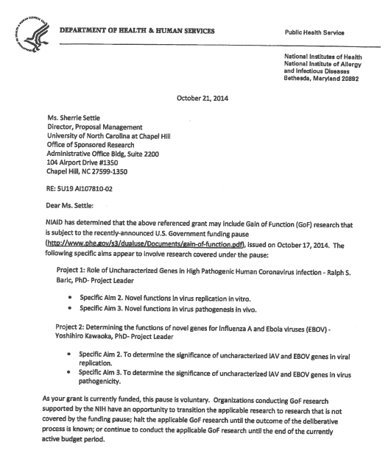
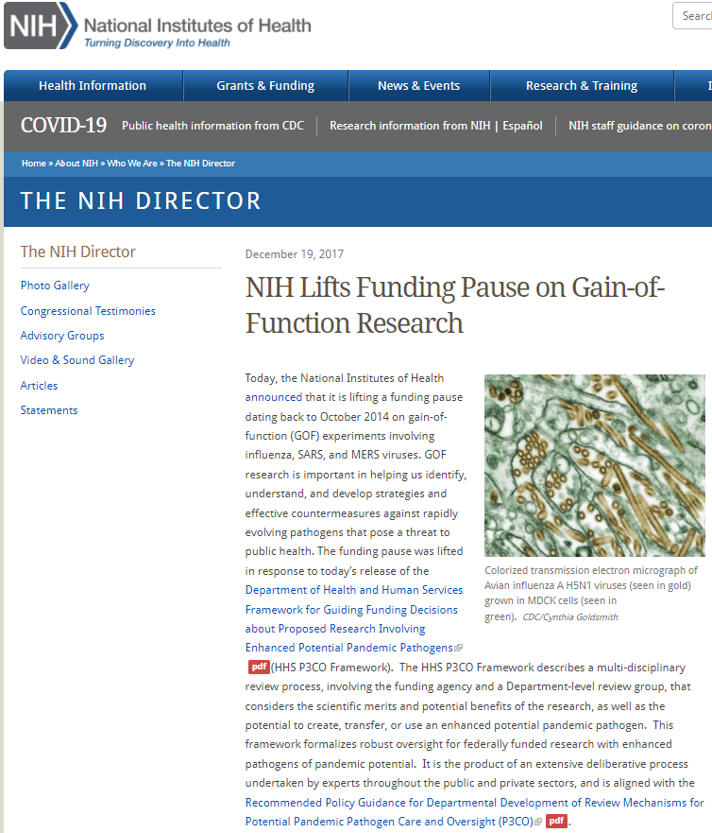
What’s the Evidence?... that Senator Rand Paul cannot seem to find
Weaponization of Coronavirus through Gain of Function
The “Smoking Gun”
“Novel functions in virus pathogenesis in vivo”

